Slide 2
About Us and Our Event
We are a club open to all ages and diversities with over 250 Members
A highly Inclusive and dynamic membership
Running for over 10 years
We run one of Seaford's Largest free events run from donations
We make 1600 torches to burn on our night bringing the community together
Cost over £22,000 to put on in 2022, with it ever increasing
Lit the Jubilee Beacon on behalf of the Town Council
New for 2023 – A summer Fete

Slide 3
Seaford Bonfire 2022

Slide 4
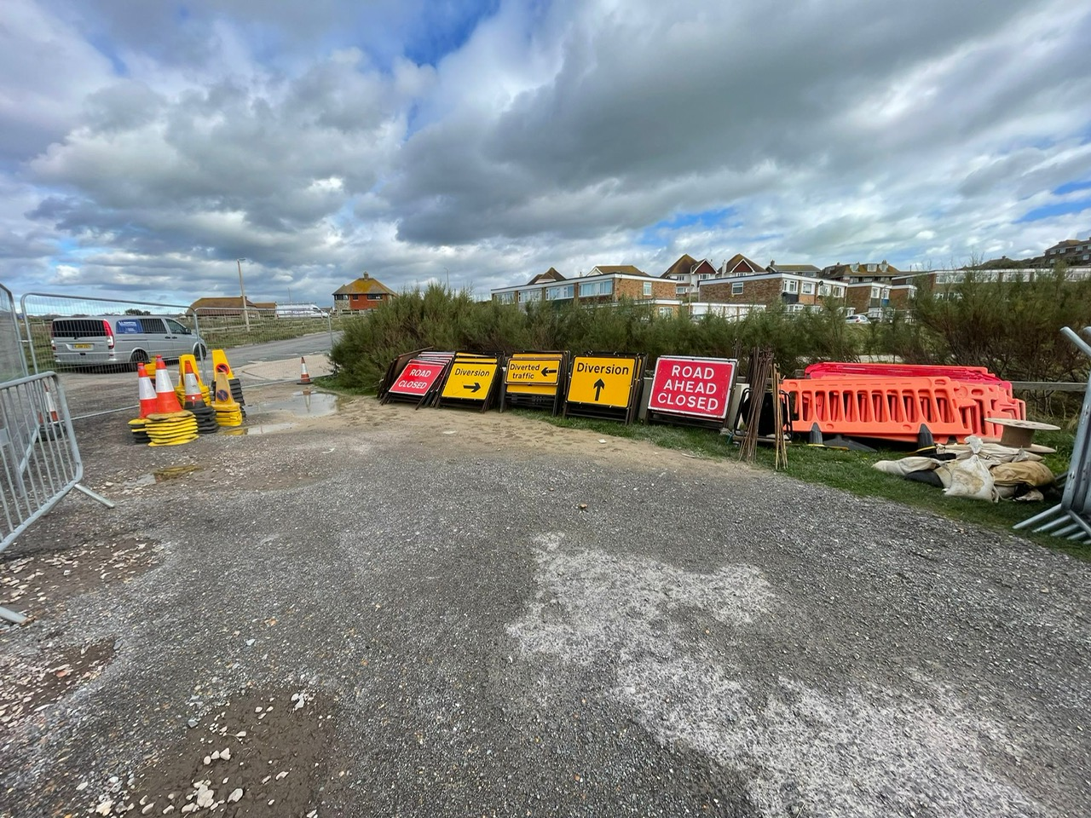
Photo Album
by Andy Bishop

Slide 5
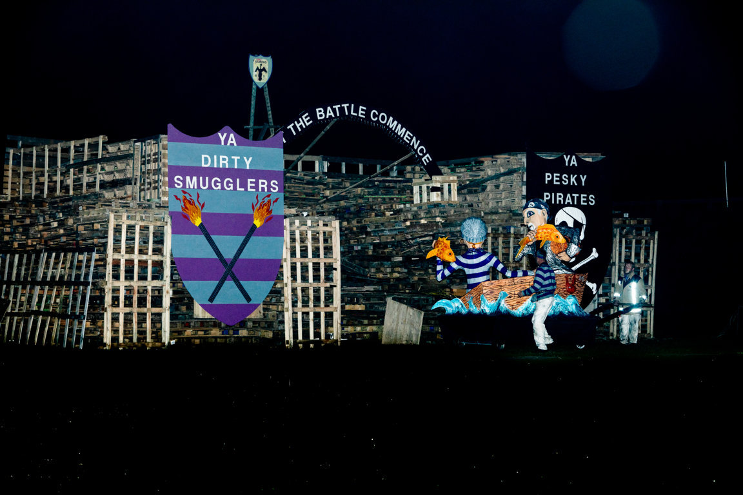

Slide 6
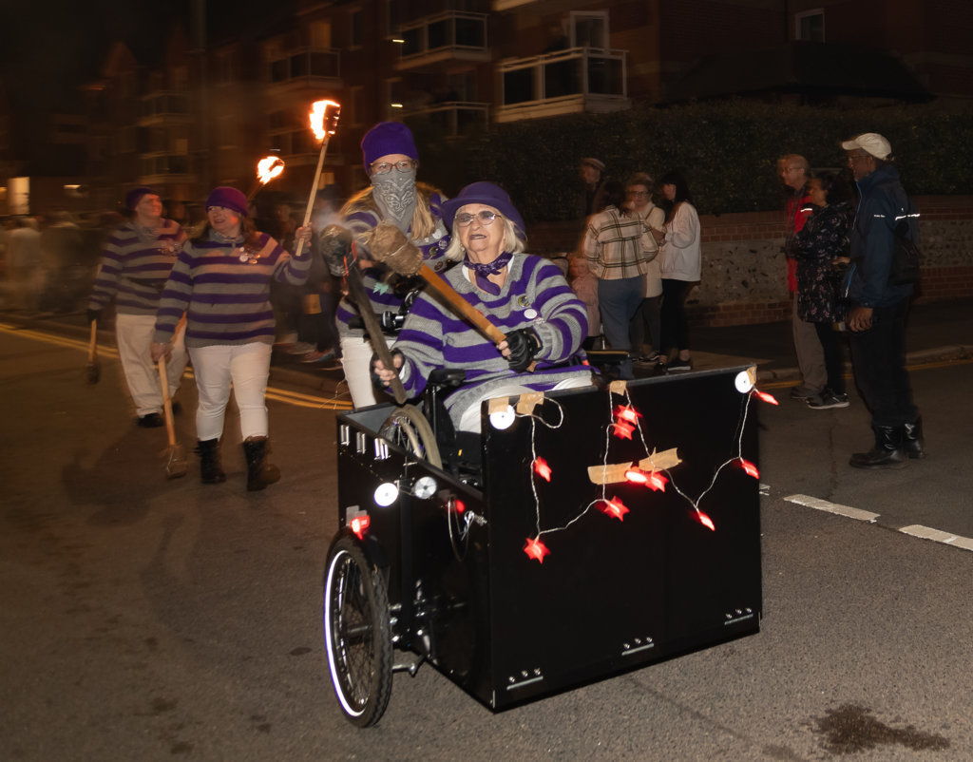

Slide 7
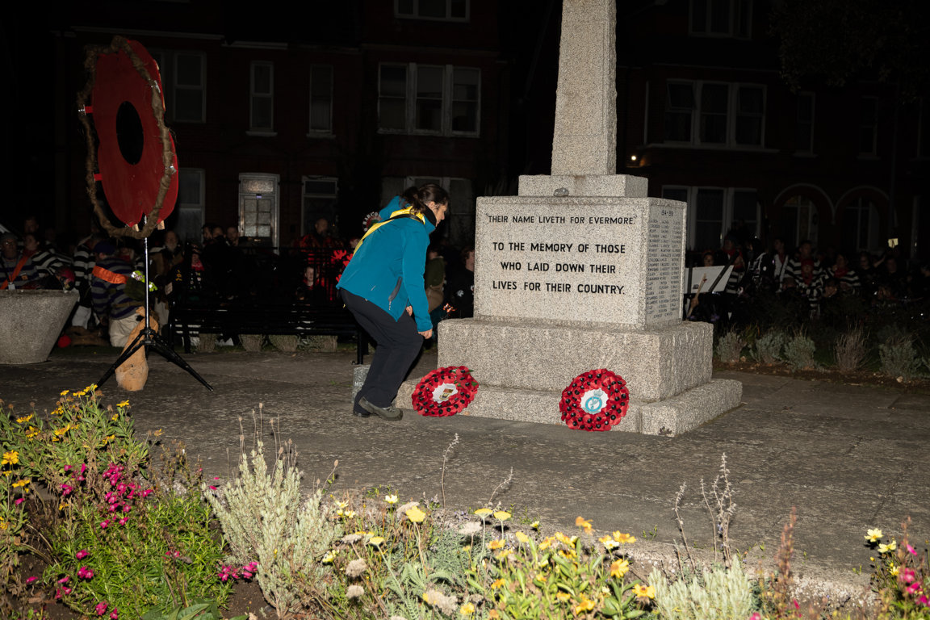

Slide 8
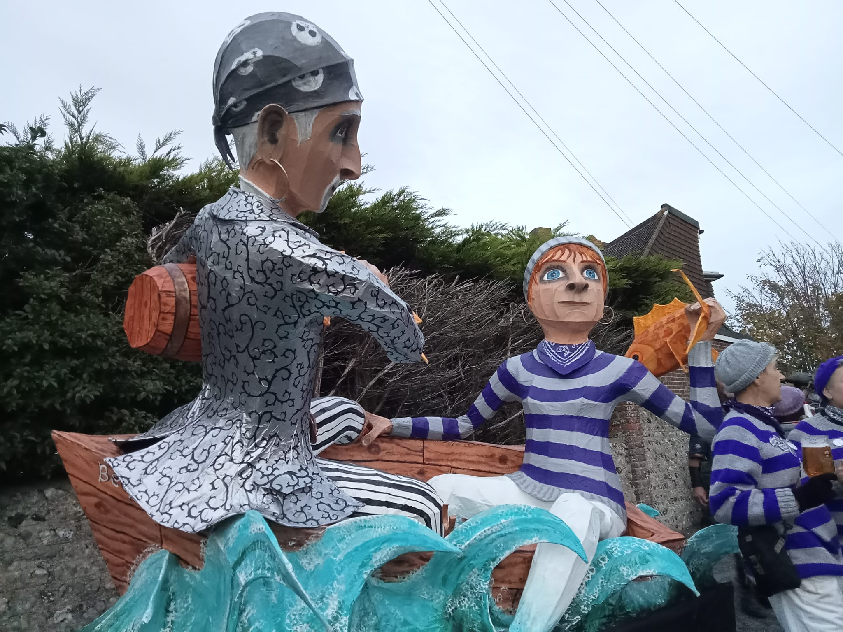

Slide 9
