Slide 1
Funding our Care
for the people of Seaford

Slide 2
Seaford Town Council
2023 Community Care use of cars serving the Seaford community - £1,100
2022 Community Nursing car costs - £2,000
2021 Community Nursing diagnostic kits - £1,100
2020 Laptops for community team - £2,000

Slide 3
Seaford Care at Home
Care at Home Team – 12 weeks of care from once per day to four times a day, until the patient’s death
Occupational therapy and physiotherapy visits when needed
Clinical team visits – once a week
Family members invite staff to funerals, come in to hospice café for coffee and sometimes become volunteers

Slide 4
Seaford patient info
2021-22 – Community Nursing team supported 130 patients and their families, with 573 visits made to homes.
2022 – 23 – Community Nursing team again supported 130 patients and their families but with 707 home visits
May 2034 – Currently have 170 patients registered from Seaford GP Surgeries. First 7 weeks of 2023 we have made 68 home visits to our Seaford patients.
These patients registered with the two Seaford GP surgeries

Slide 5
Services we offer in Seaford
Seaford and Polegate hub comprises CNS Karen, development CNS Oliver, three Reg Nurses Charlie, Rachel and Lisa.
Help with symptoms and advance care planning
Holistic approach looking at everything in these four domains: physical, spiritual, emotional and psychological and they support the whole family
A number of Seaford patients attend the Living Well Drop in Hub 2-4pm on a Tuesday afternoon - group for patients and carers with an emphasis on social connection, patients can see a nurse if needed
About to start a carers group from 2.30-3.30 on a Tuesday

Slide 6
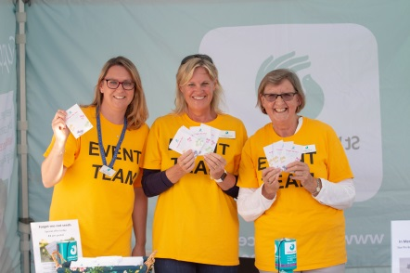
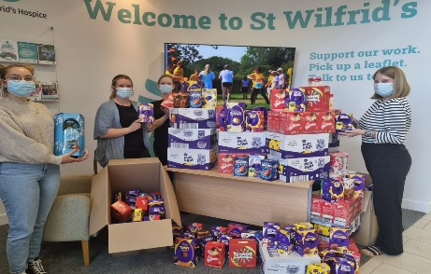
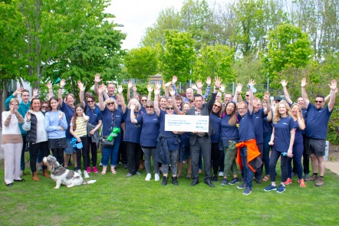
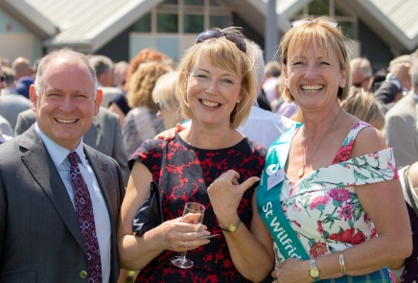
Host or join an event
Join our lottery
Volunteer with us
Make a donation
Visit our Seaford shop
Follow us on social media
Leave a memory on our tree or memory book
Tell your friends and families about this presentation today
How the Seaford community can support us

Slide 7
Events
Attracts new supporters and extends our reach
Events include Firewalk, Sky Dives, Wilf Walk, Starlight Stroll and Rainbow Run
Details can be found at stwhospice.org

Slide 8
Business support
Businesses can get involved through donations, event sponsorship, team building days, matched funding for employees
Do you know of a company who might attend our networking Business Breakfasts?
Can you think of anywhere we could place a collection box?

Slide 9
Trust Funded Projects total £350k income
Children’s Bereavement Service funded £35k by BBC Children in Need
Spiritual support including part time post: £40K Good News Evangelical Trust
Occupational therapy - £10K from Hospital Saturday Fund
Physiotherapy - £1k from D’Oyle Carte Charitable Trust

Slide 10
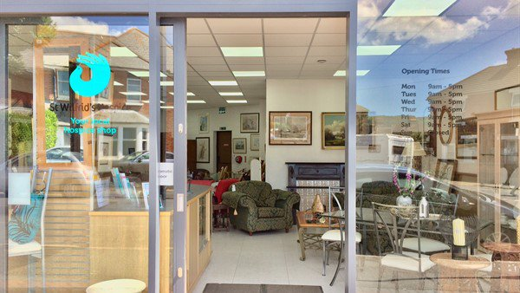
Retail
9 charity shops – our high street face
Donation Centre and house clearances
E-bay: responding to the change in shopping habits
Etsy/Vinted/Depop
Shop with us, buy online, encourage people to volunteer in our shops – they can try a taster day.

Slide 11
Legacies
One in three of our nurses is funded by legacies
How can you help?
Know who donors can contact for assistance/a chat
Spread the word about the importance of legacies to the hospice
Let people know about September Make a Will month
Tell people about our free seminars on a range of legacy related topics

Slide 12
On behalf of all our Seaford patients, their families and loved ones – thank you to
Seaford Town Council for
your ongoing support!
We couldn’t do all this without you!
Thank you

