Slide 1
Seaford Town Council
2023
Cuckmere Buses – a charity

Slide 2
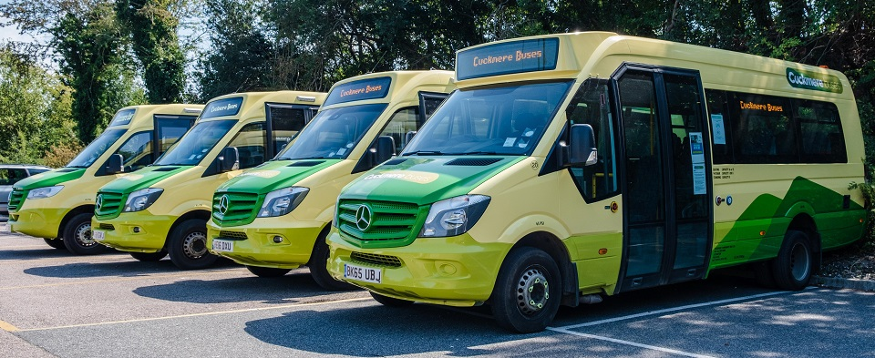
Some of the Cuckmere Buses fleet

Slide 3
Seaford is served by:
120 Monday to Saturday – serves Hawth, Bishopstone and Clementine areas every 30 mins
26 Sunday & bank holiday – Seaford to Eastbourne via Chyngton, Alfriston & Polegate
47 Rambler – Saturday, Sunday and bank holidays – hourly circular from Berwick Station to Alfriston, Chyngton, Seaford centre, Litlington and Wilmington
40 Tuesday and Friday – Berwick & villages to Seaford centre serving Kingston Way & Fairways Road area

Slide 4
Staffing
All our drivers and officers are volunteers and no payments are made
We are always looking for new volunteers

Slide 5
Funding - Income
Ticket sales
Grants including from Seaford Town Council and donations
Private hire and special services

Slide 6
Funding - expenditure
Servicing and repairs
Purchase/leasing costs
Licences and Insurance
Operational costs
Fuel

Slide 7
Passenger numbers
In Seaford area
2021 – 10,700
2022 – 16,500
Total passengers carried across all routes
2021 – 38,700
2022 – 60,900
Still below pre-covid numbers

