Slide 1
Charity No.1191294

Slide 2
9 million people in the UK across all adult ages
more than the population of London
are either always or often lonely

Slide 3
“…a subjective, unwelcome feeling of lack or loss of companionship. It happens when we have a mismatch between the quantity and quality of social relationships that we have, and those that we want.”
HM Government (2018), A connected society: A Strategy for tackling loneliness – laying the foundations for change
Perlman, D. & Peplau, L. A. (1981) Toward a Social Psychology of Loneliness.

Slide 4
940,000 older people (aged 65+) in the UK are often lonely
270,000 older people (aged 65+) in England go a week without speaking to a friend or family member
Loneliness is linked with accelerated frailty and increased risk of several diseases – including a 29% increase in risk of incident coronary heart disease and a 32% increase in risk of stroke.
19% of carers aged 65+ (around 287,000 people) felt lonely because of the care or support they provide.

Slide 5
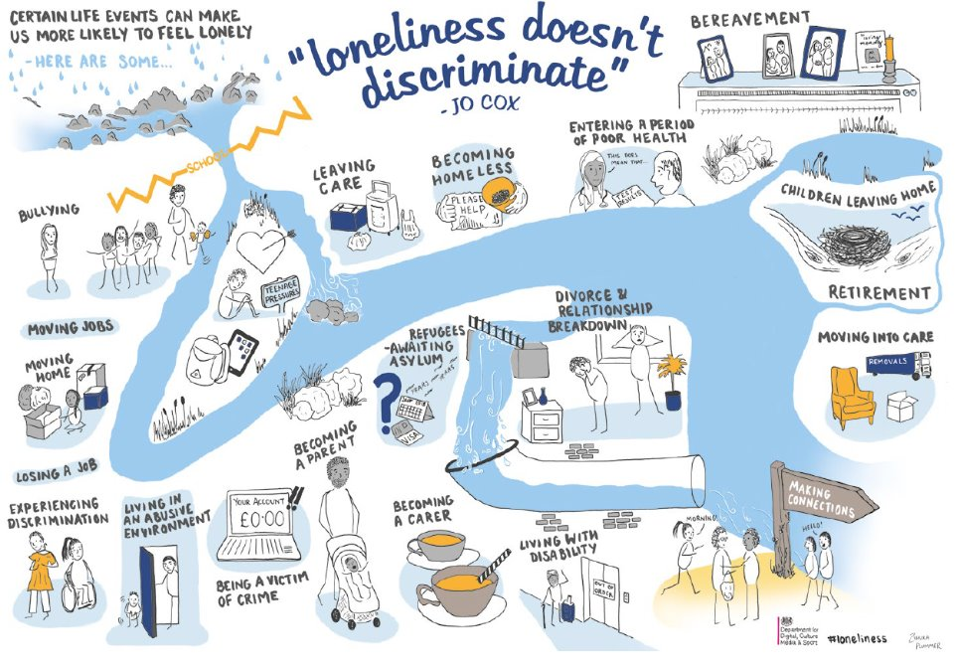

Slide 6
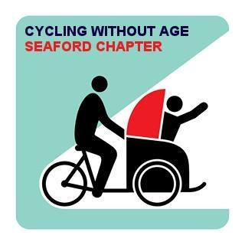
Who Are We ?
Seaford Rotary
Martello Rotary

Slide 7
1-2-1 Befriending

Slide 8
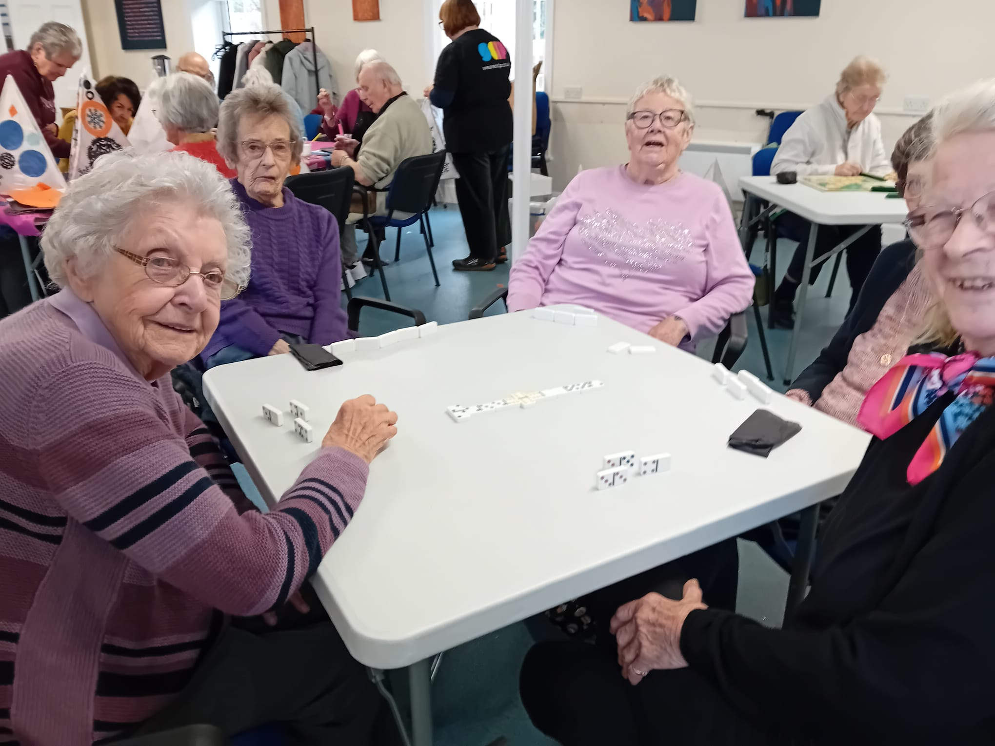
Coffee Mornings

Slide 9
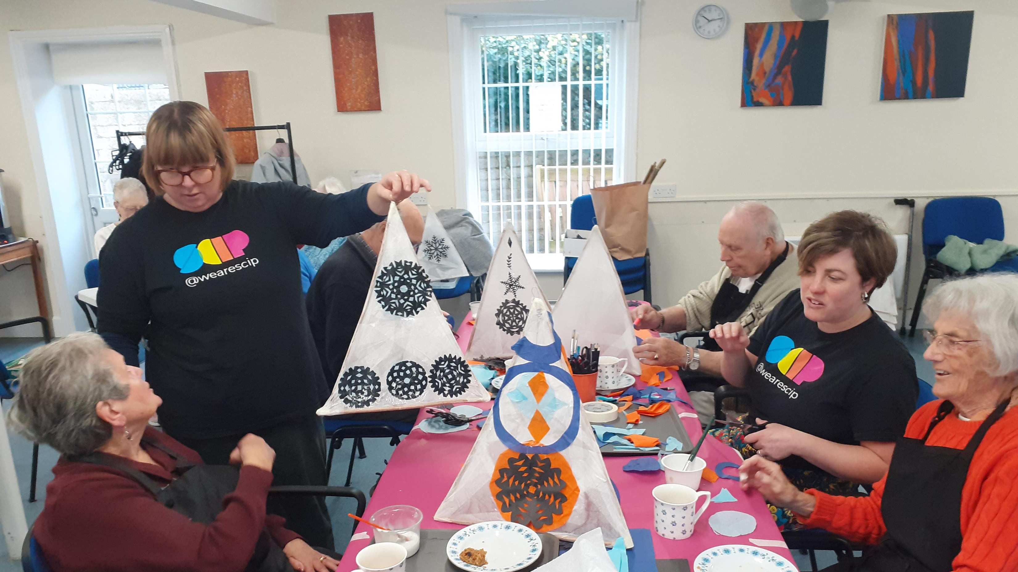

Slide 10
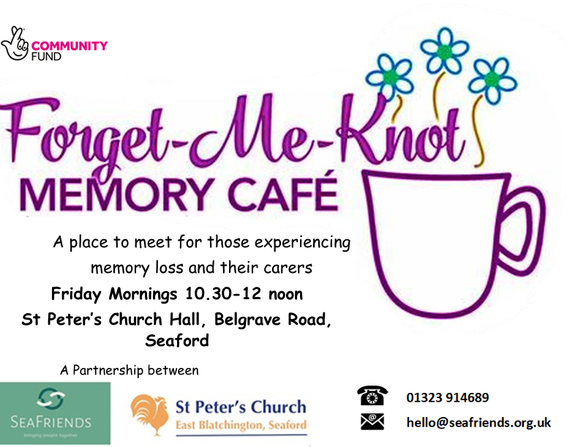

Slide 11
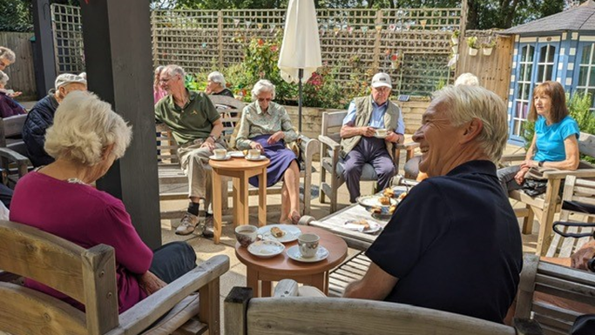

Slide 12
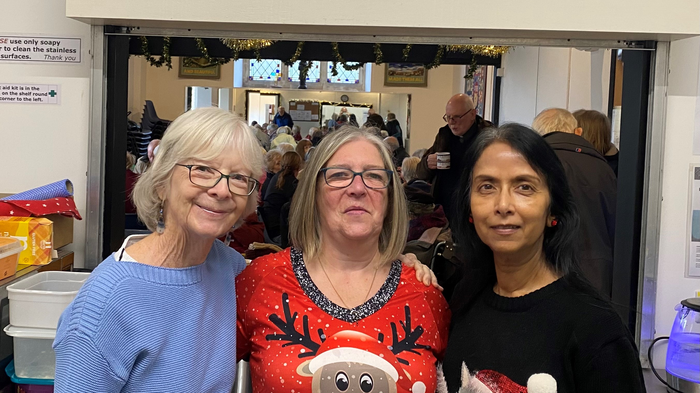

Slide 13
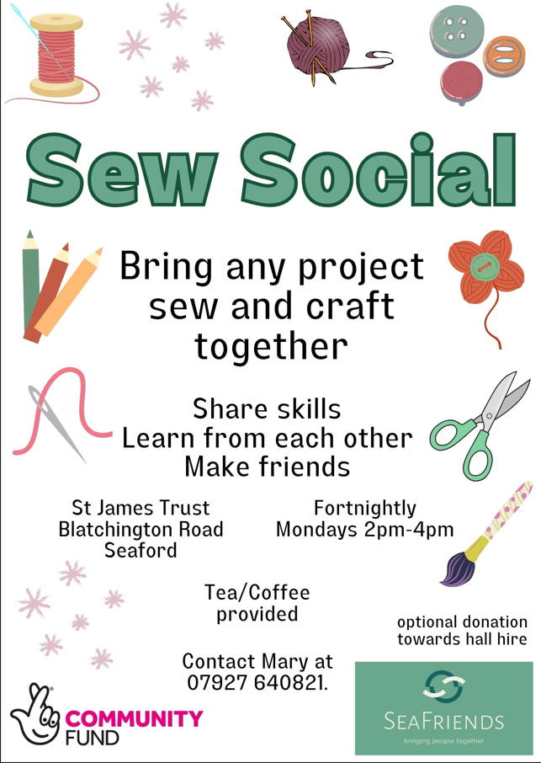

Slide 14
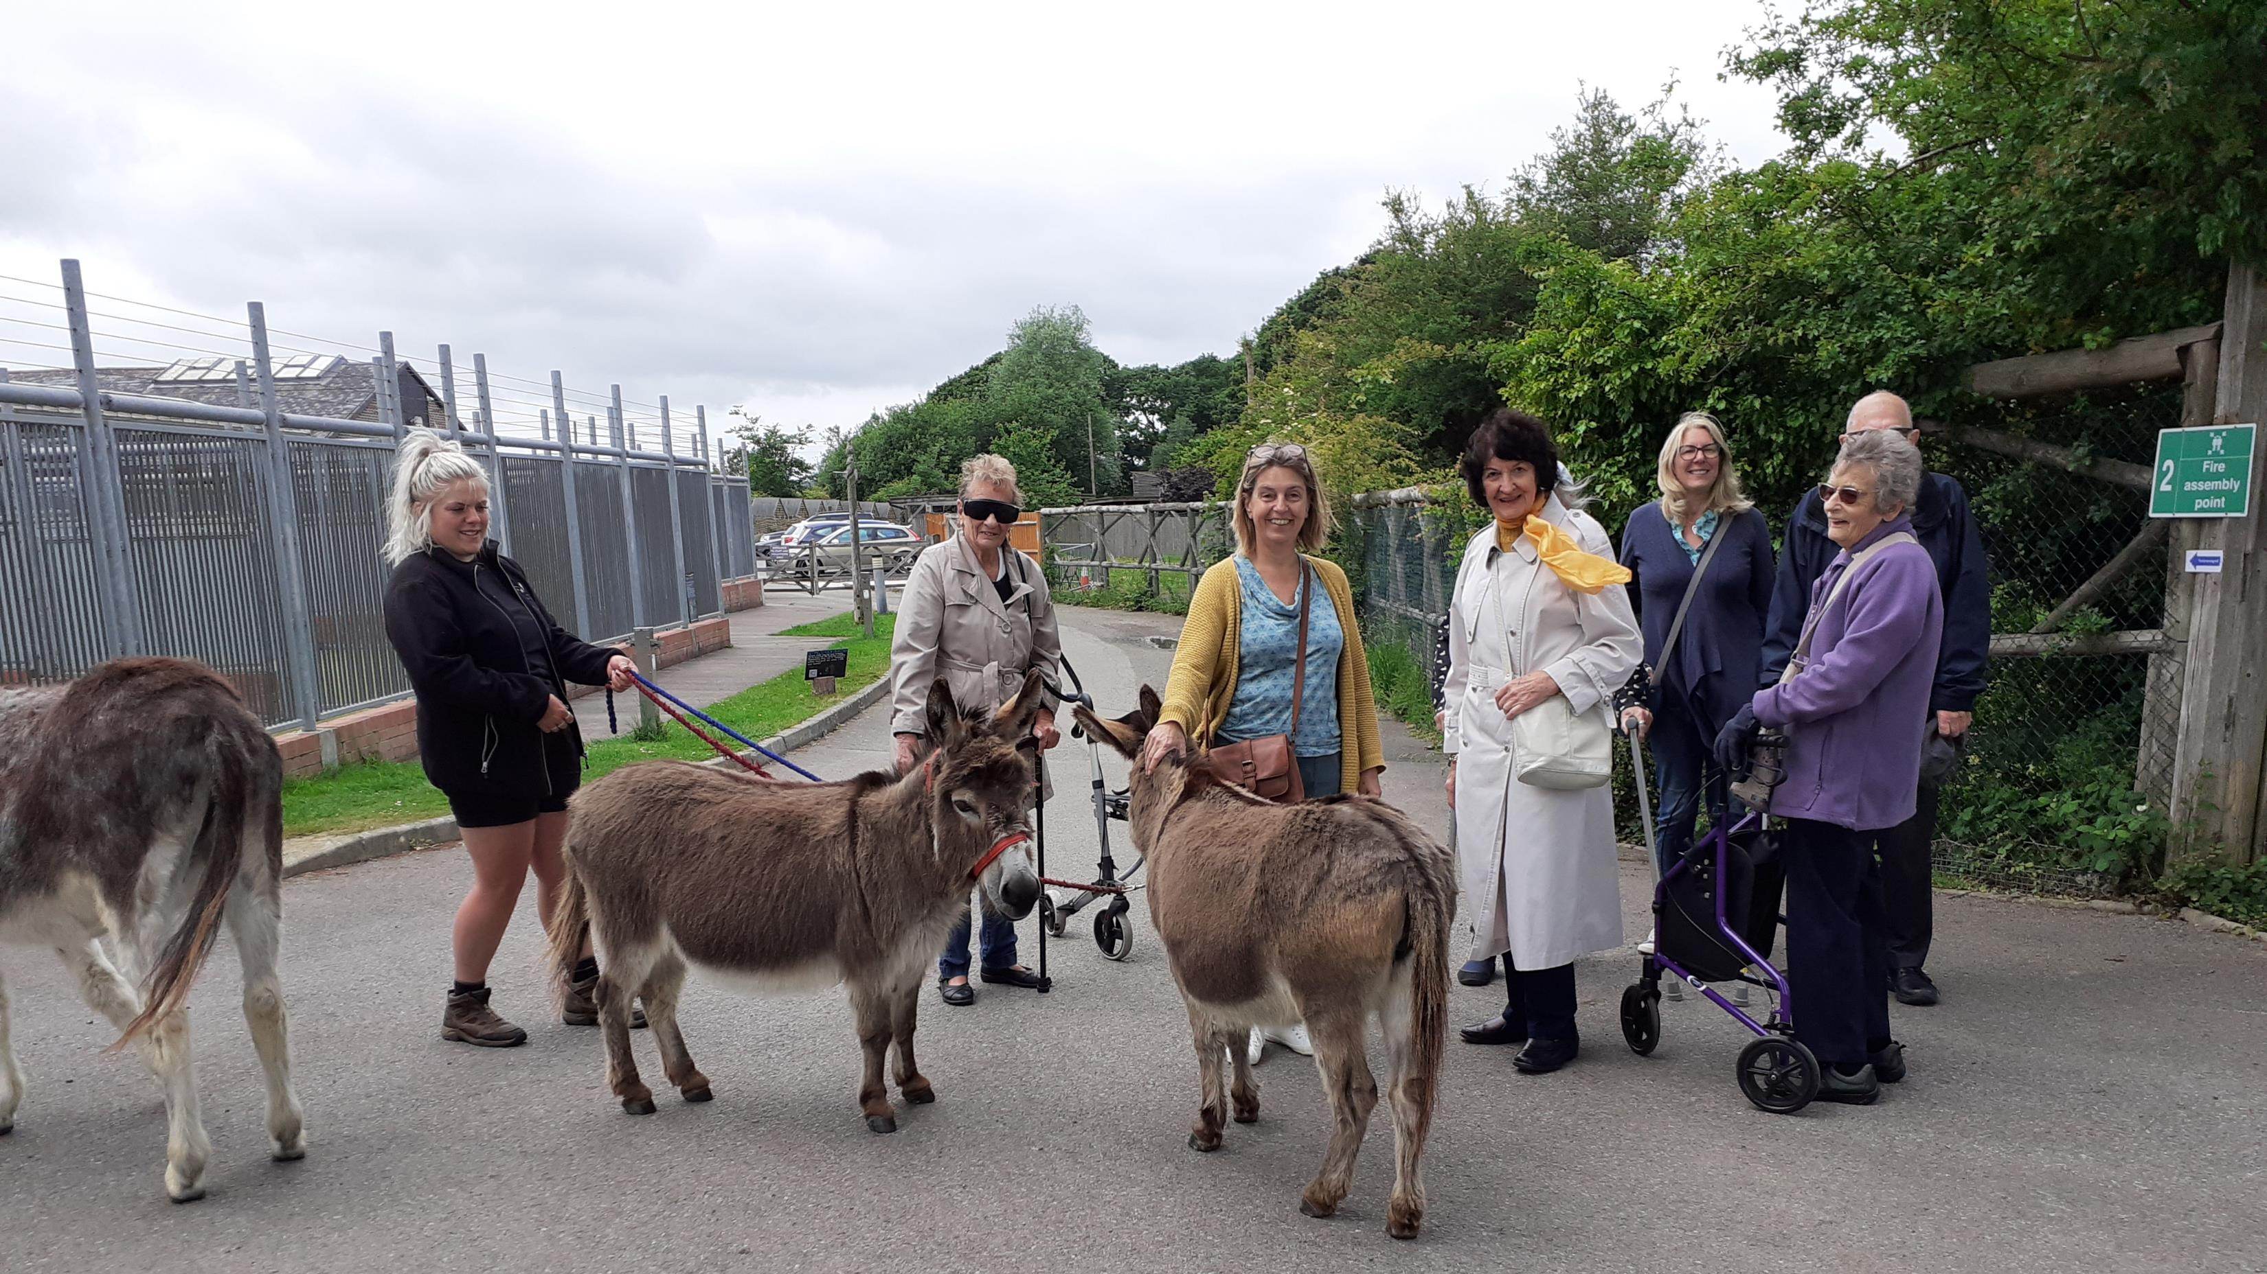
Day
Trips

Slide 15
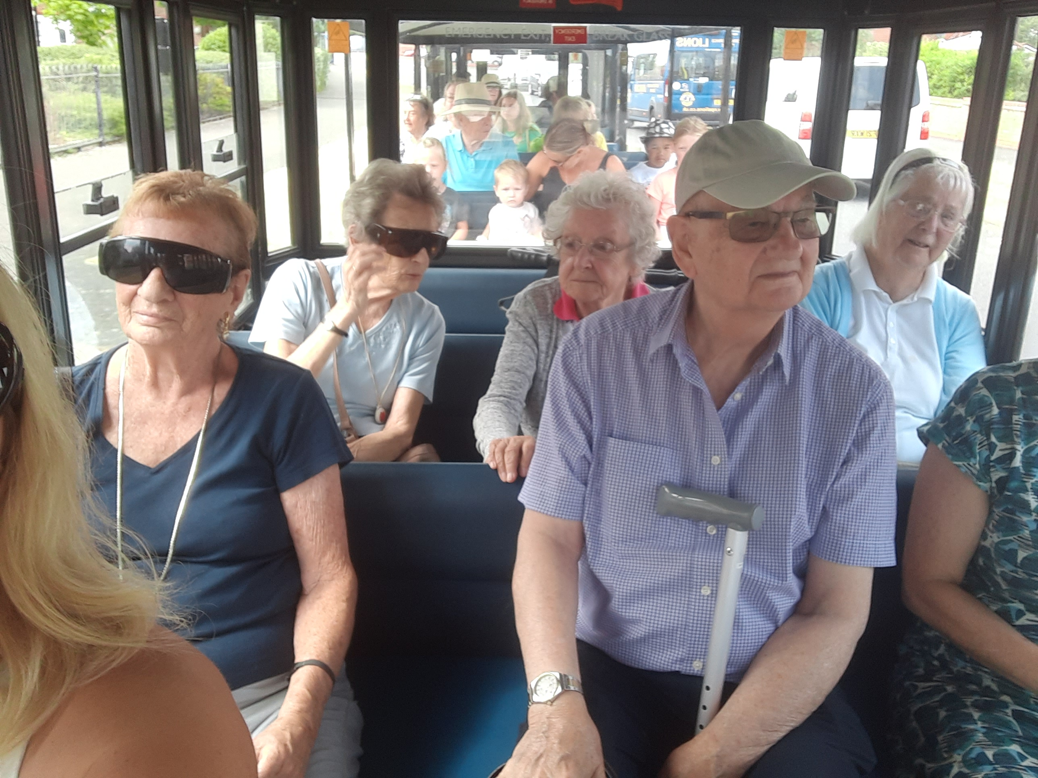

Slide 16
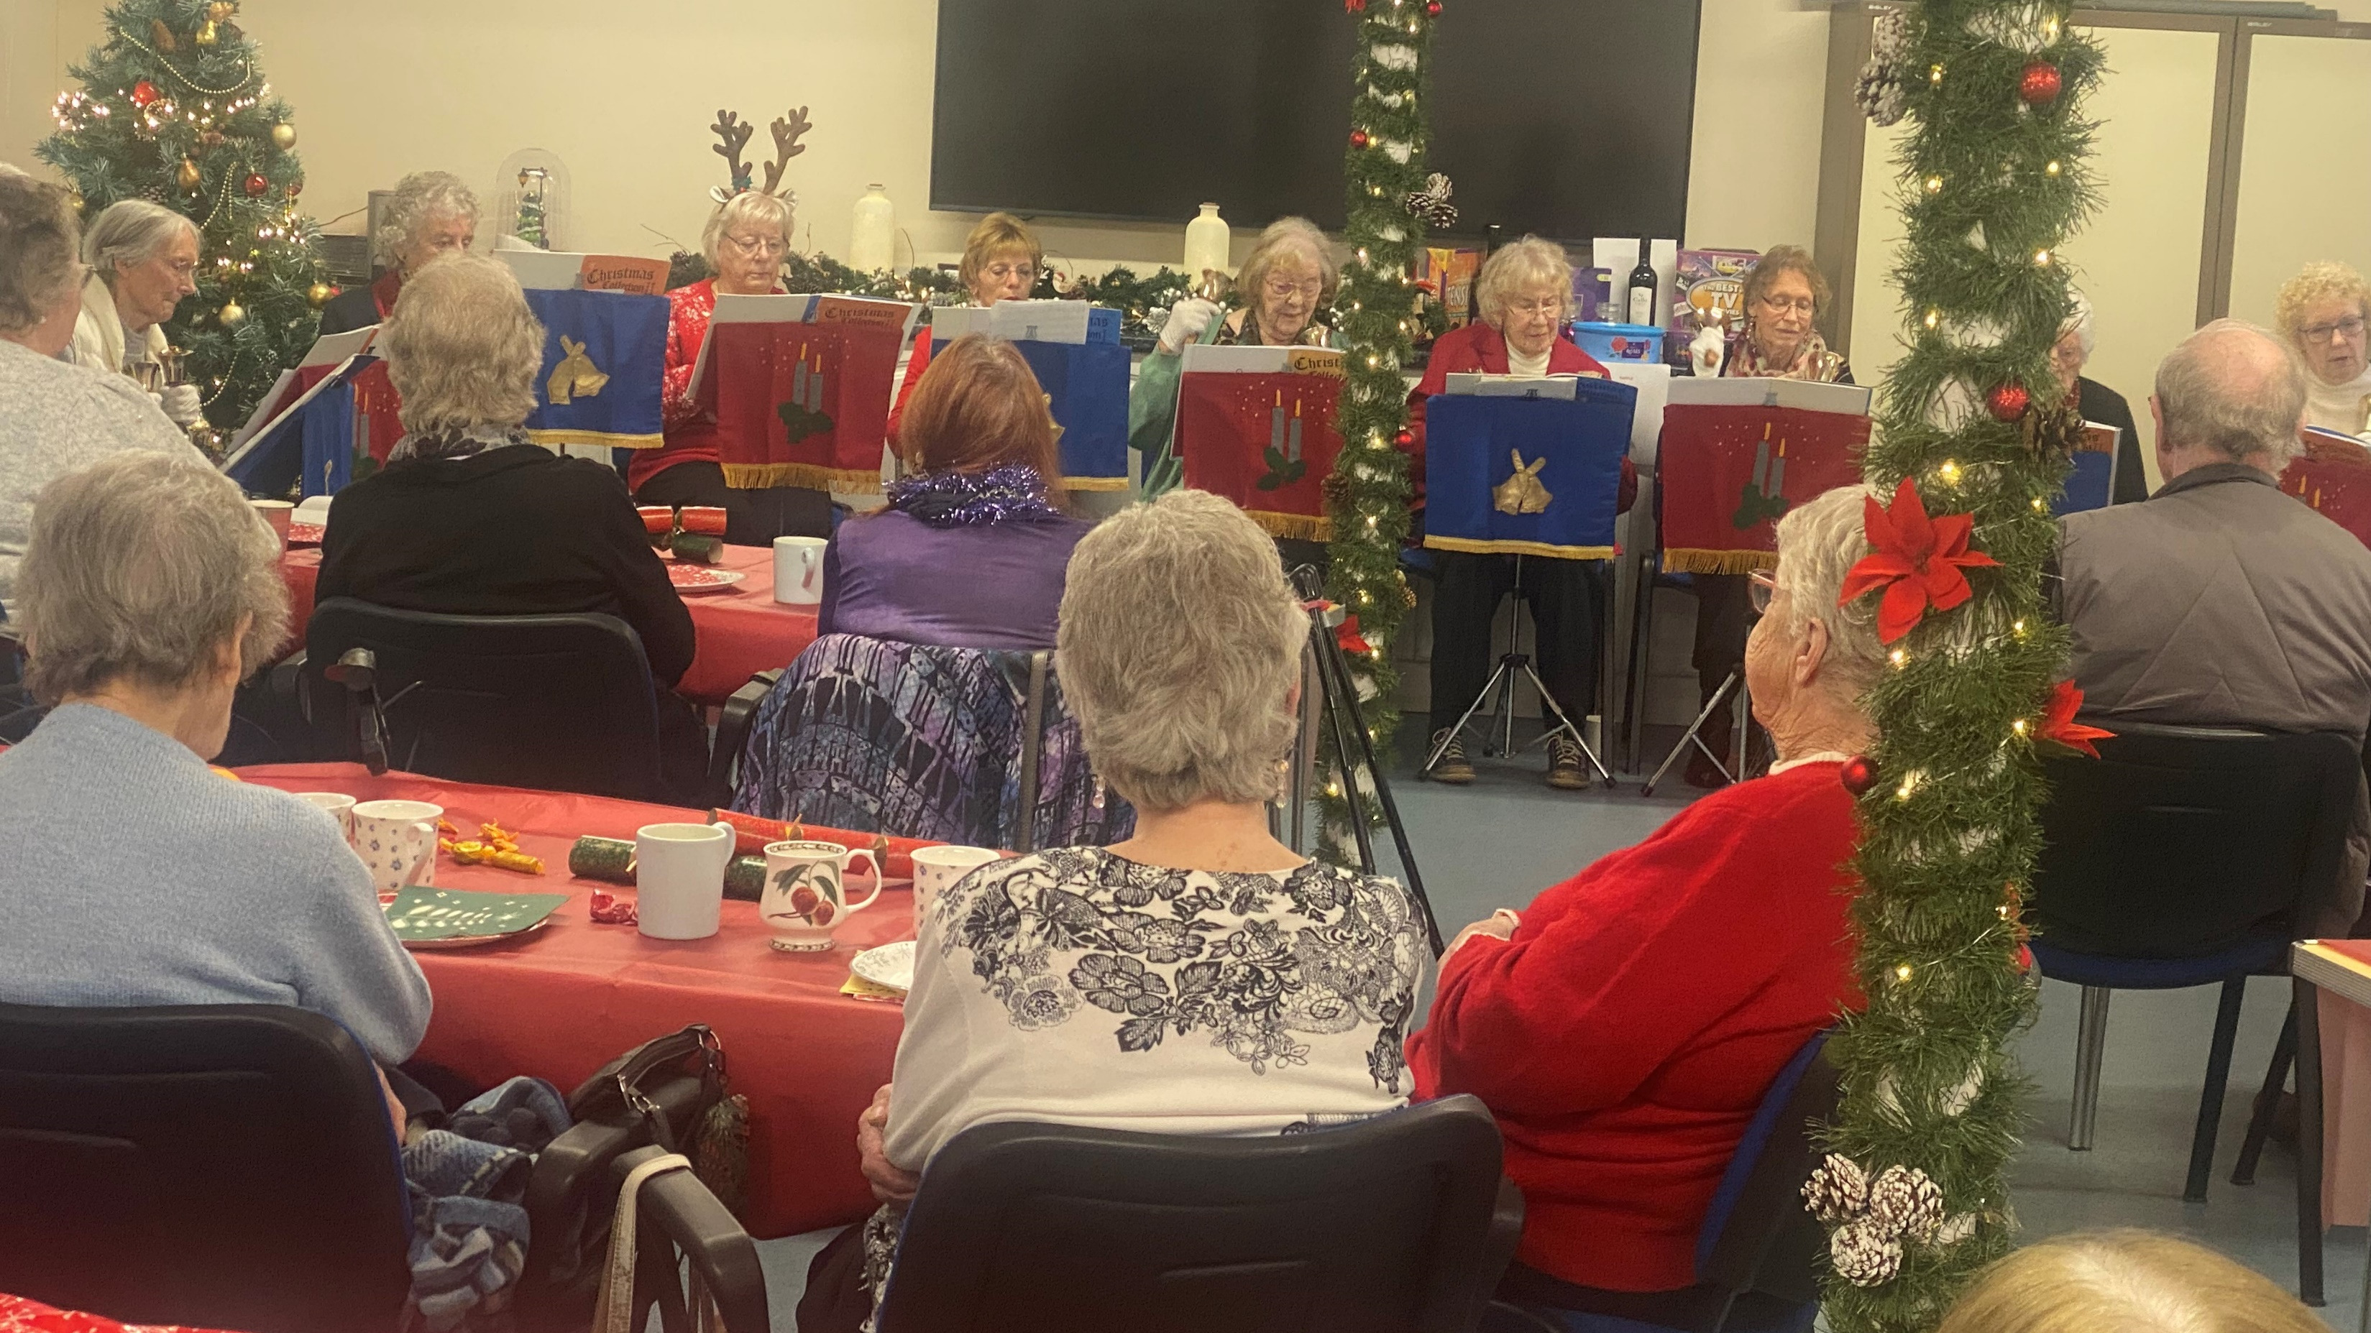
Christmas
Parties

Slide 17
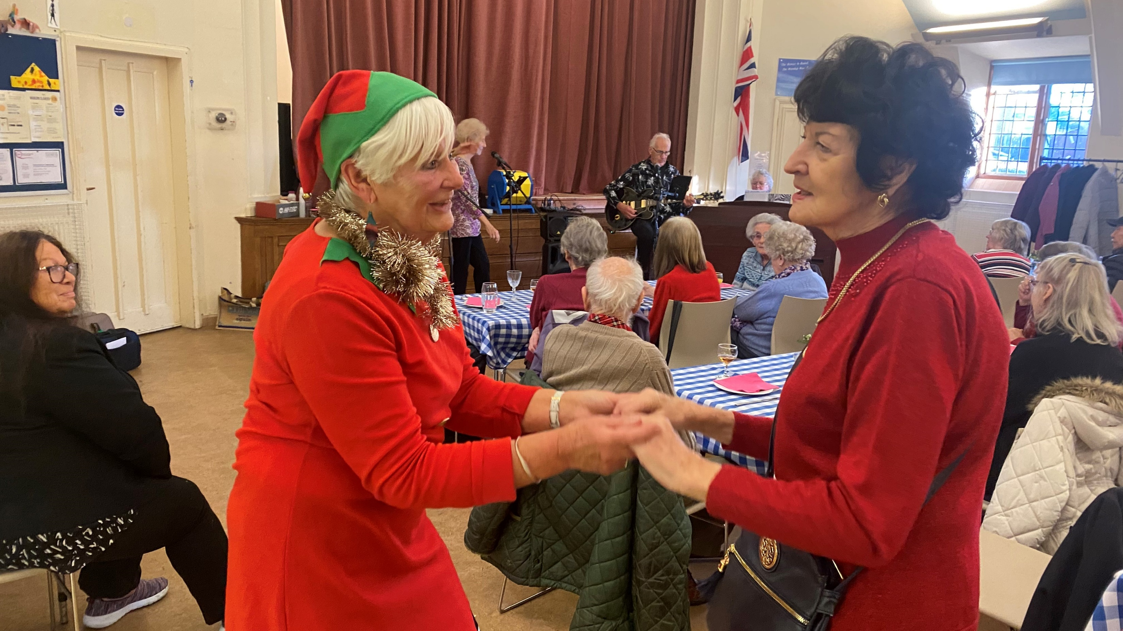

Slide 18
Relaxed Cinema Screenings

Slide 19
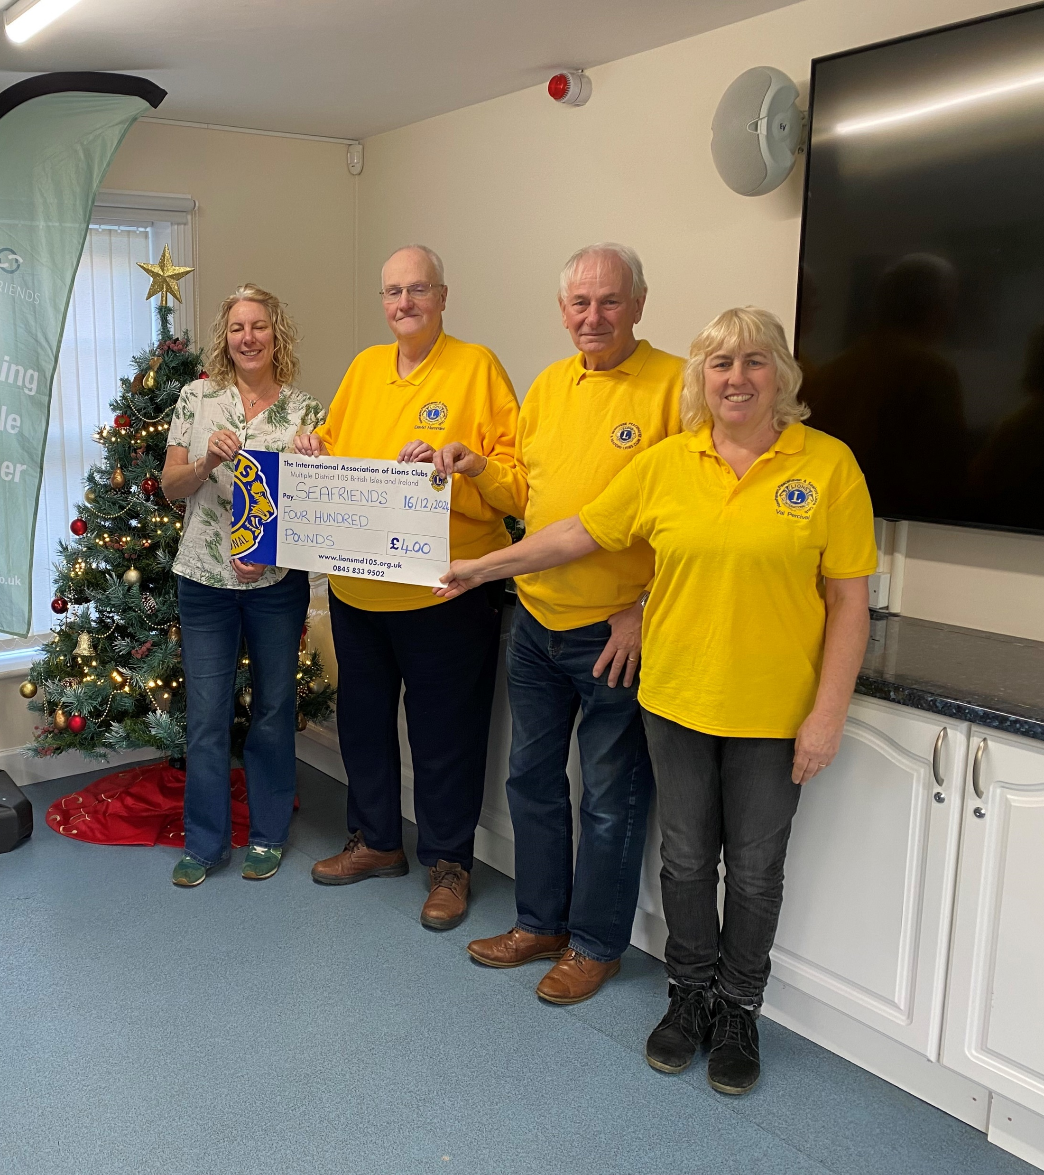

Slide 20
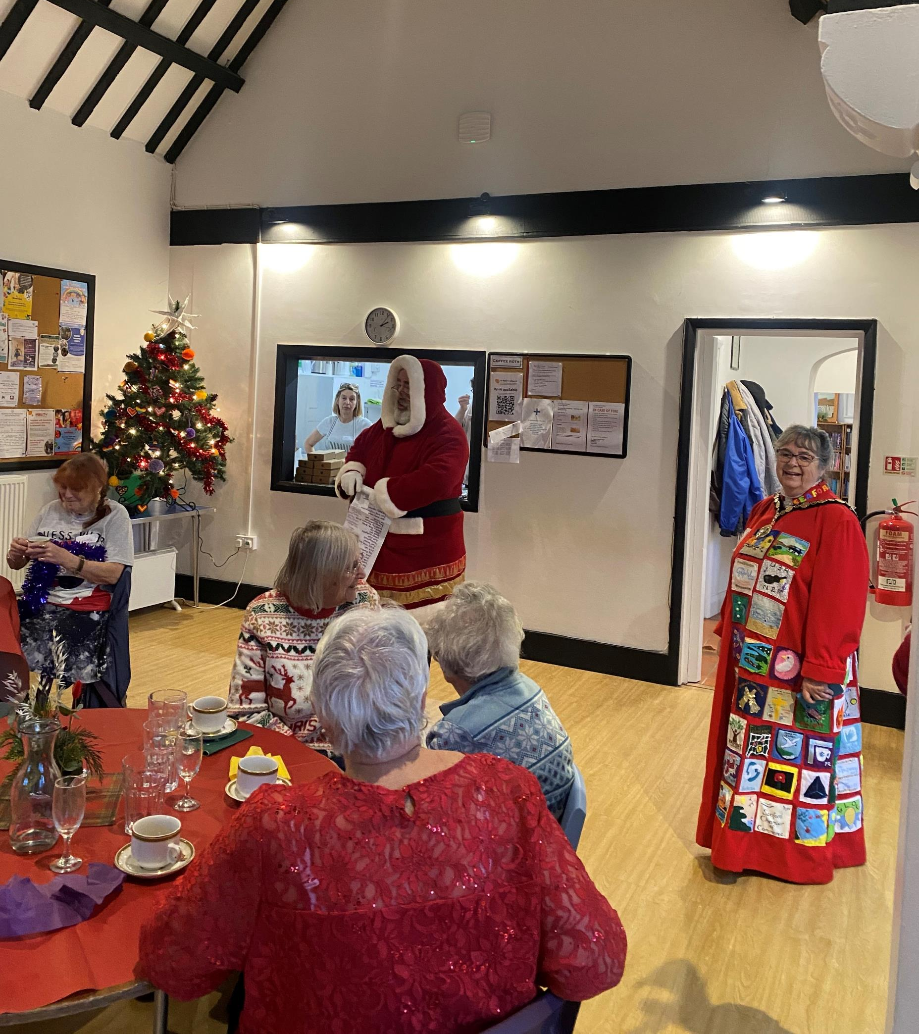
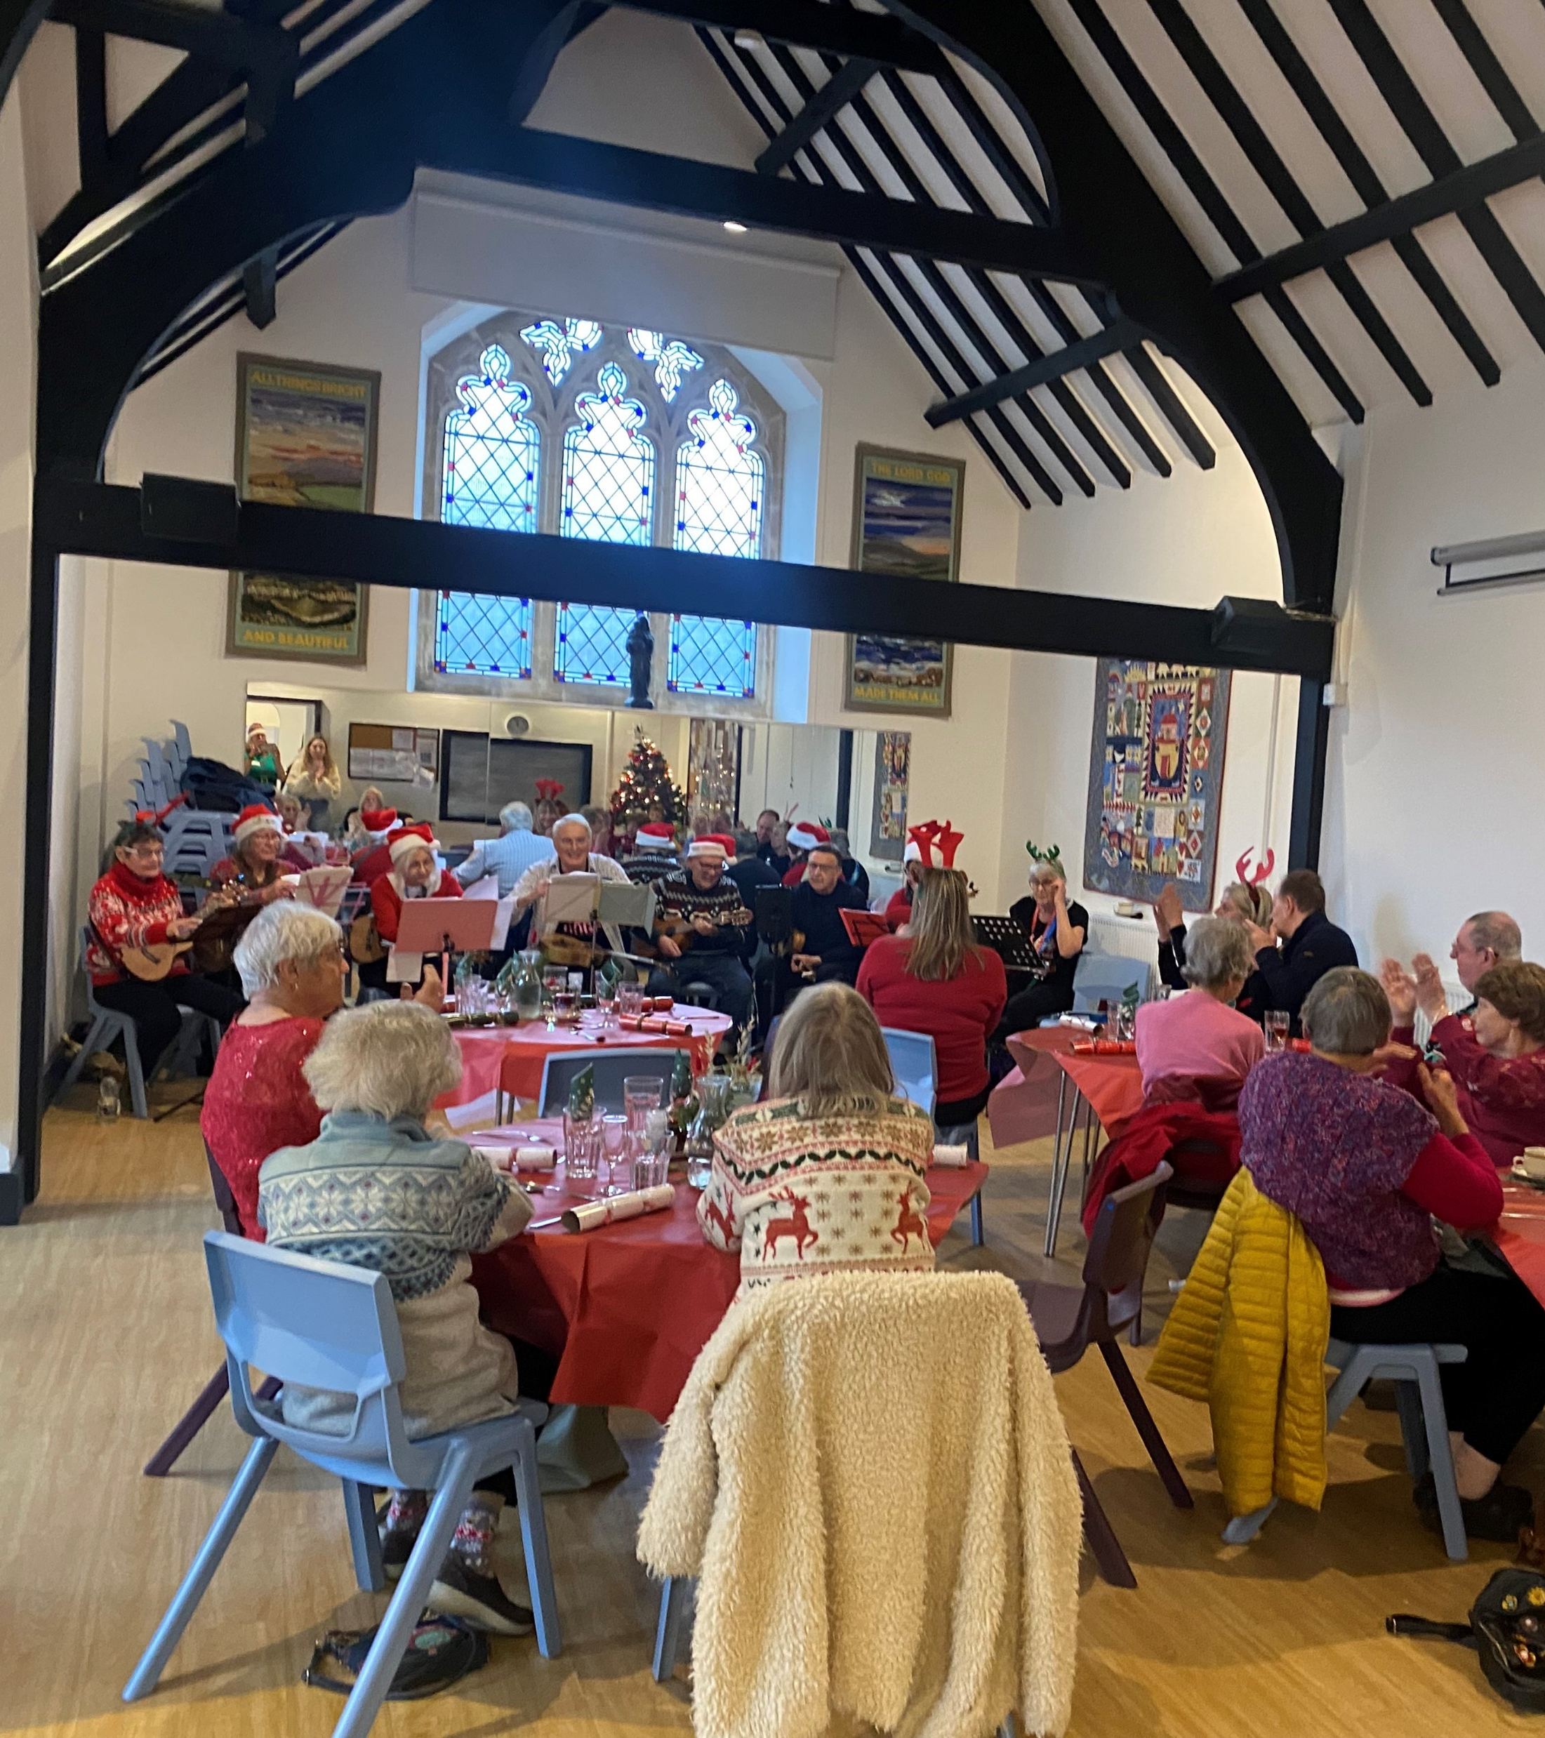

Slide 21
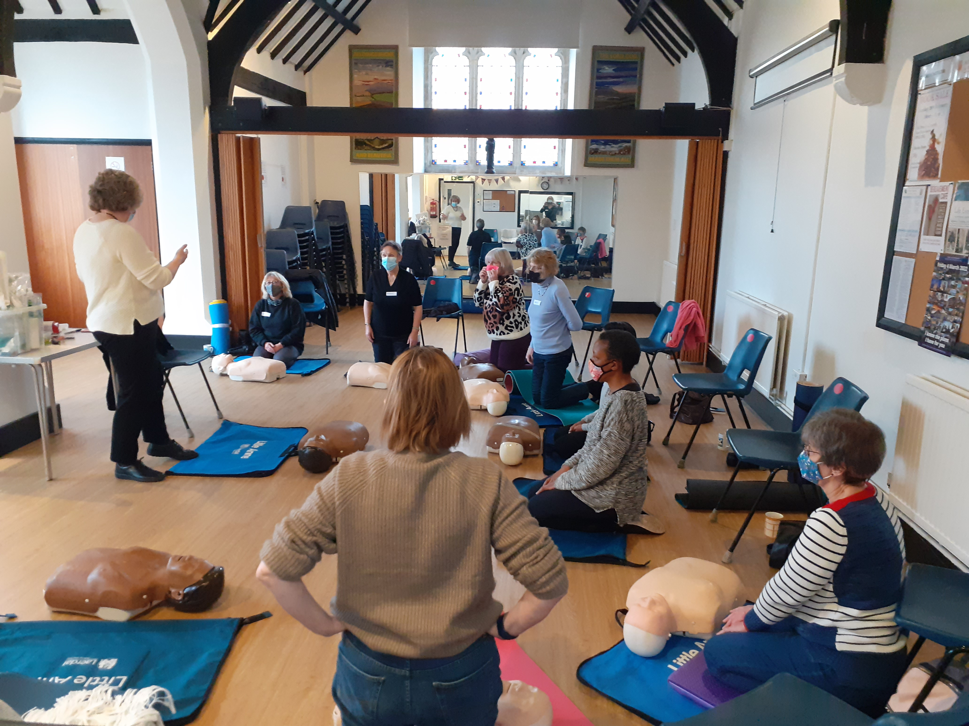
Volunteers

Slide 22
So what are the plans for 2025

Slide 23
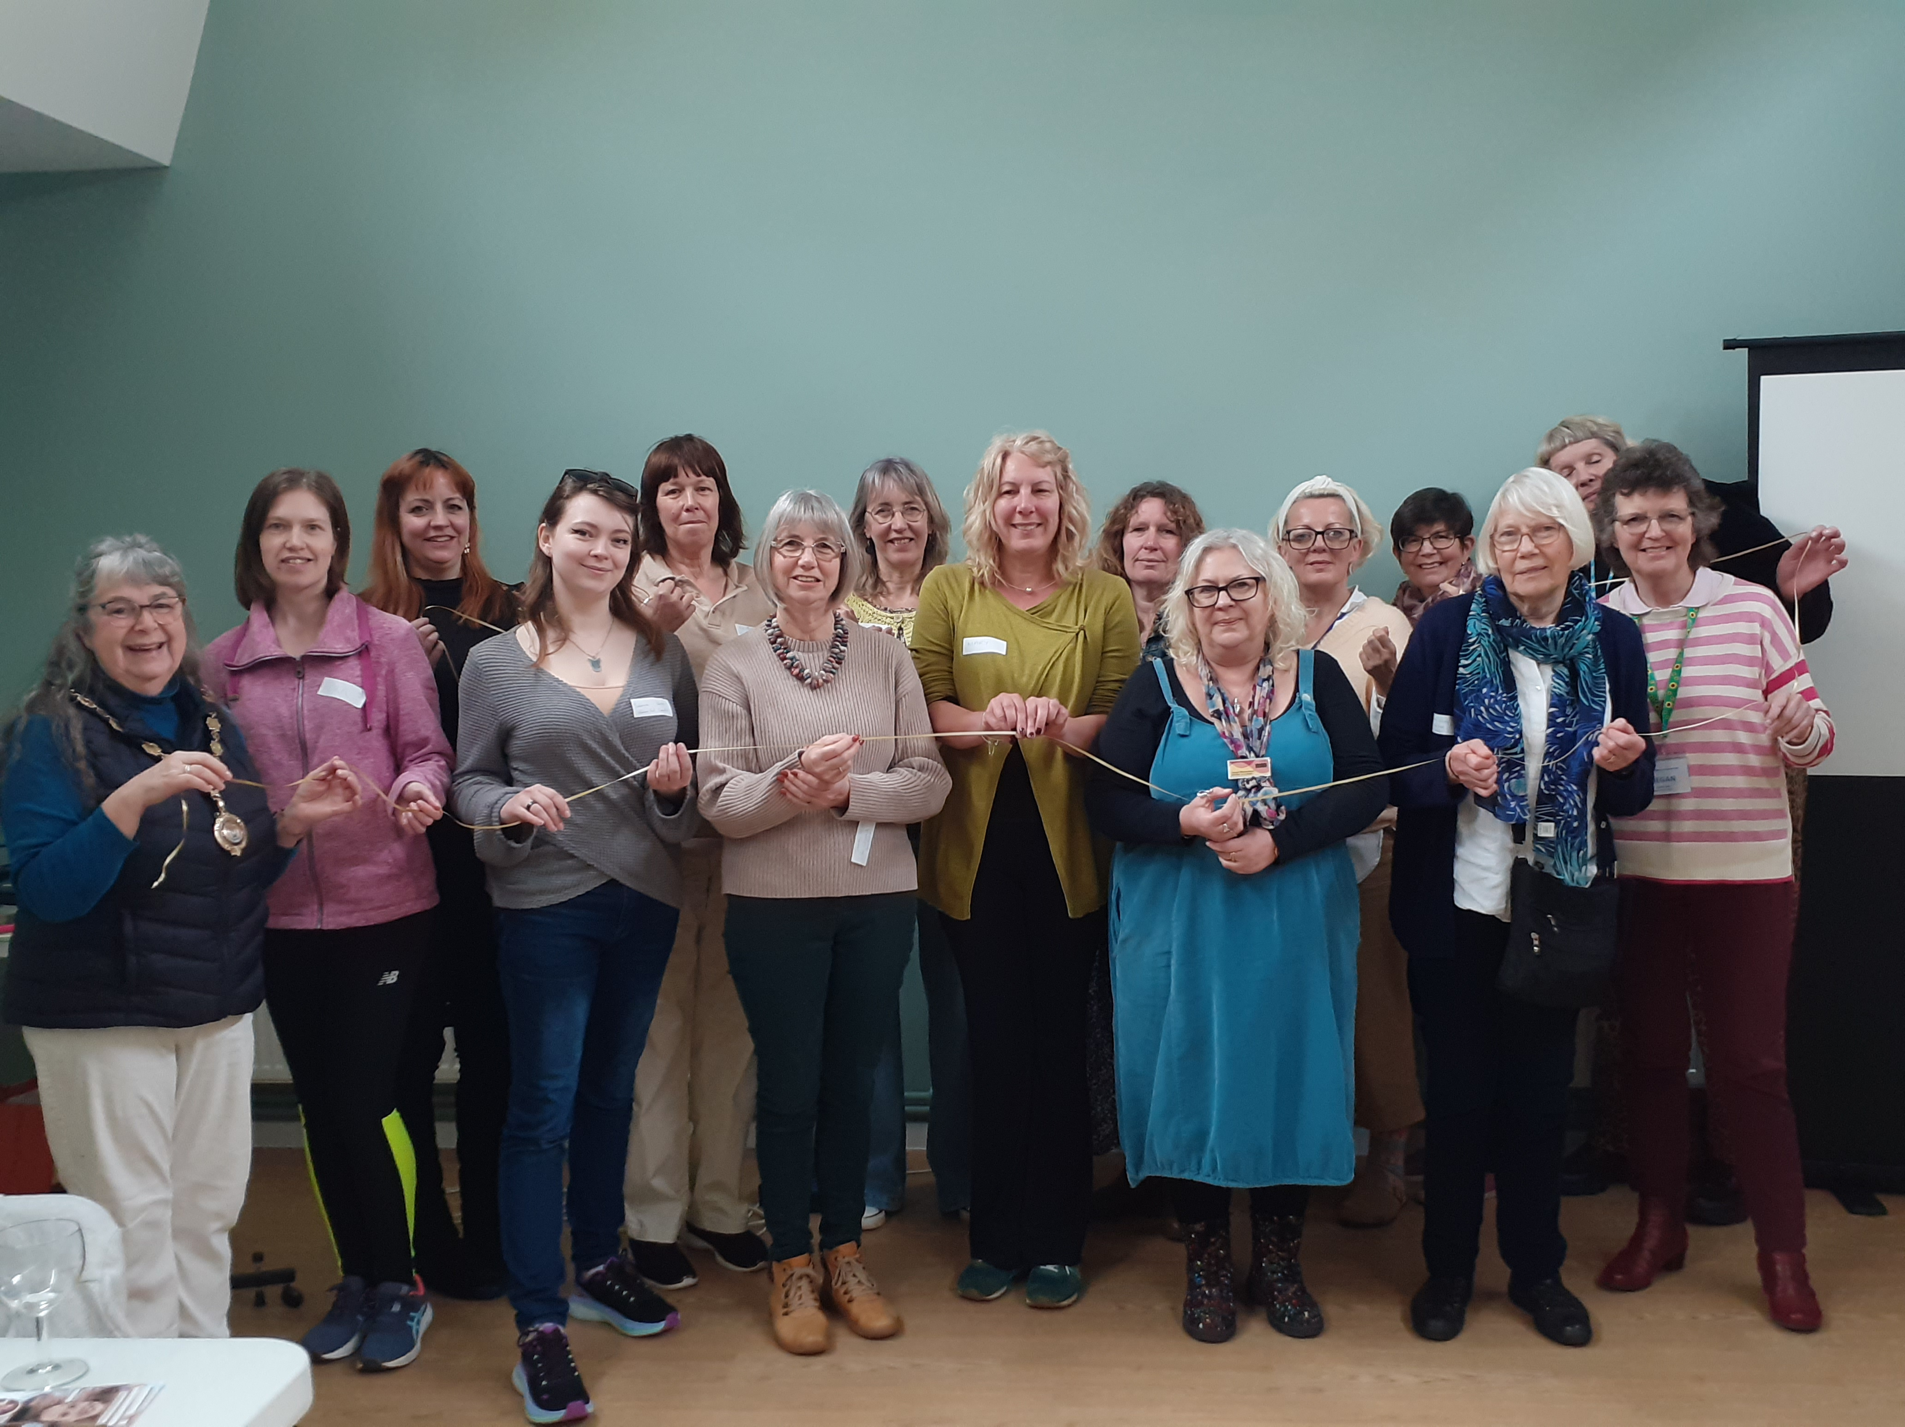
Seaford Community Group Network Lunches

Slide 24
Seaford Seniors Spring
Soiree

Slide 25
Our aim is to consider ways of supporting small local projects, sharing carpentry skills and helping local organisations with challenging tasks.
96% Reduction in loneliness amongst Shed members
(UKMSA Health and Wellbeing Survey 2023)

Slide 26
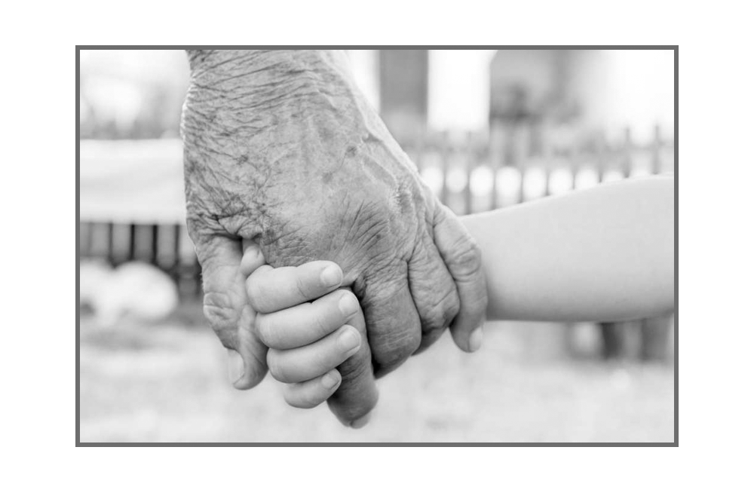
Tel: 07927640821
Email: hello@seafriends.org.uk

